Slide 1
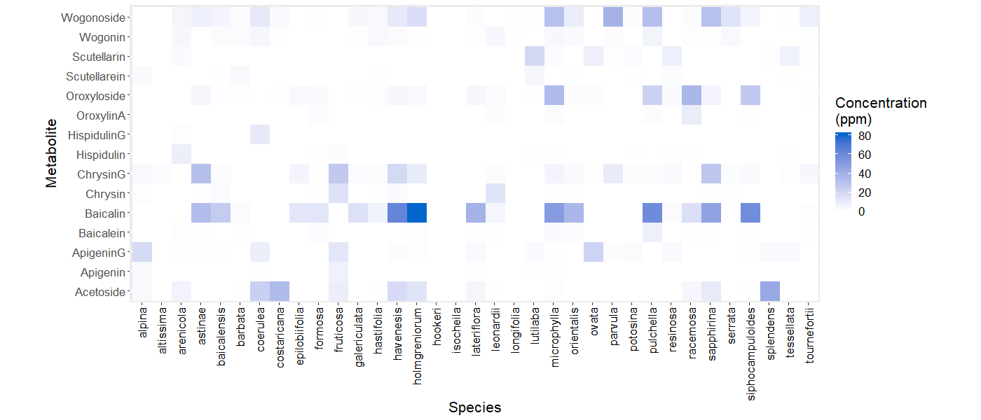
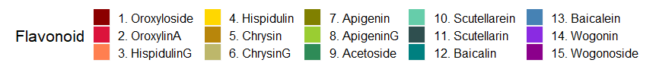
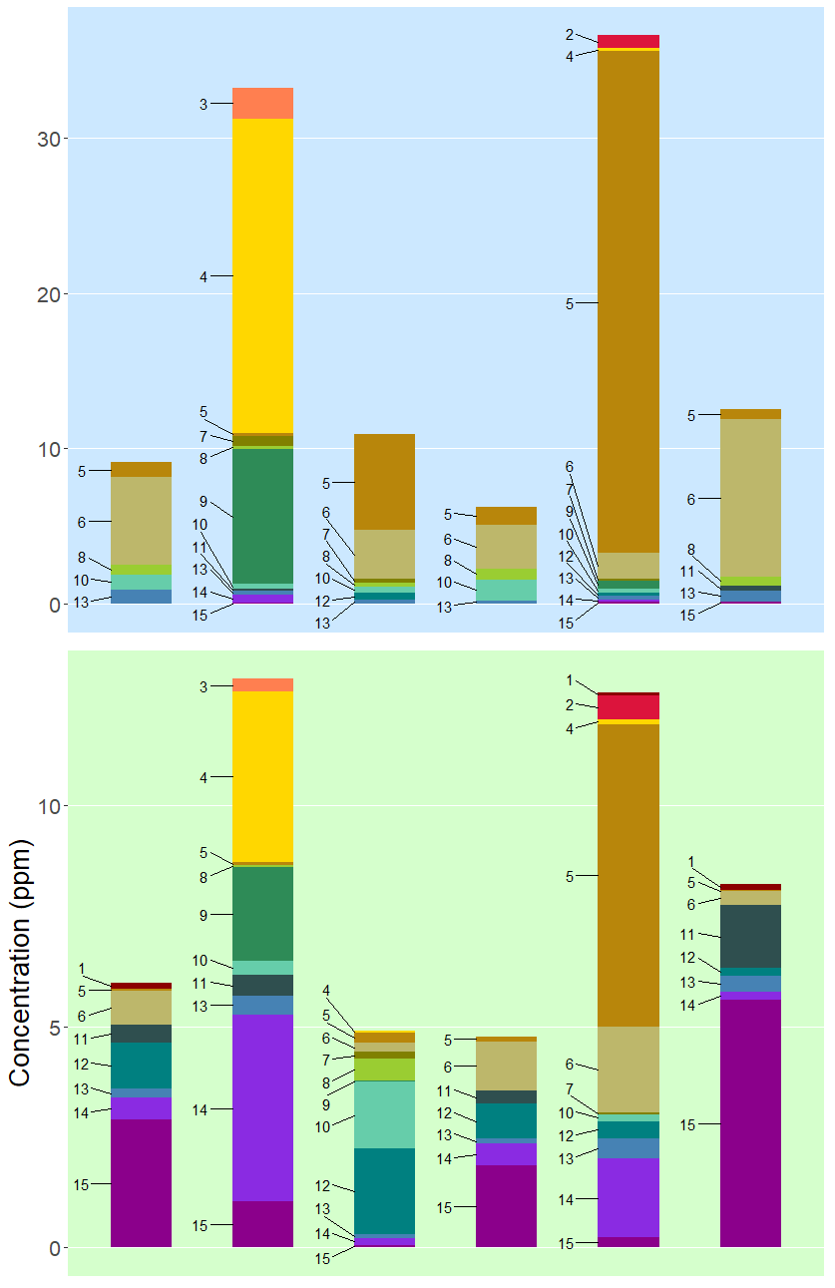
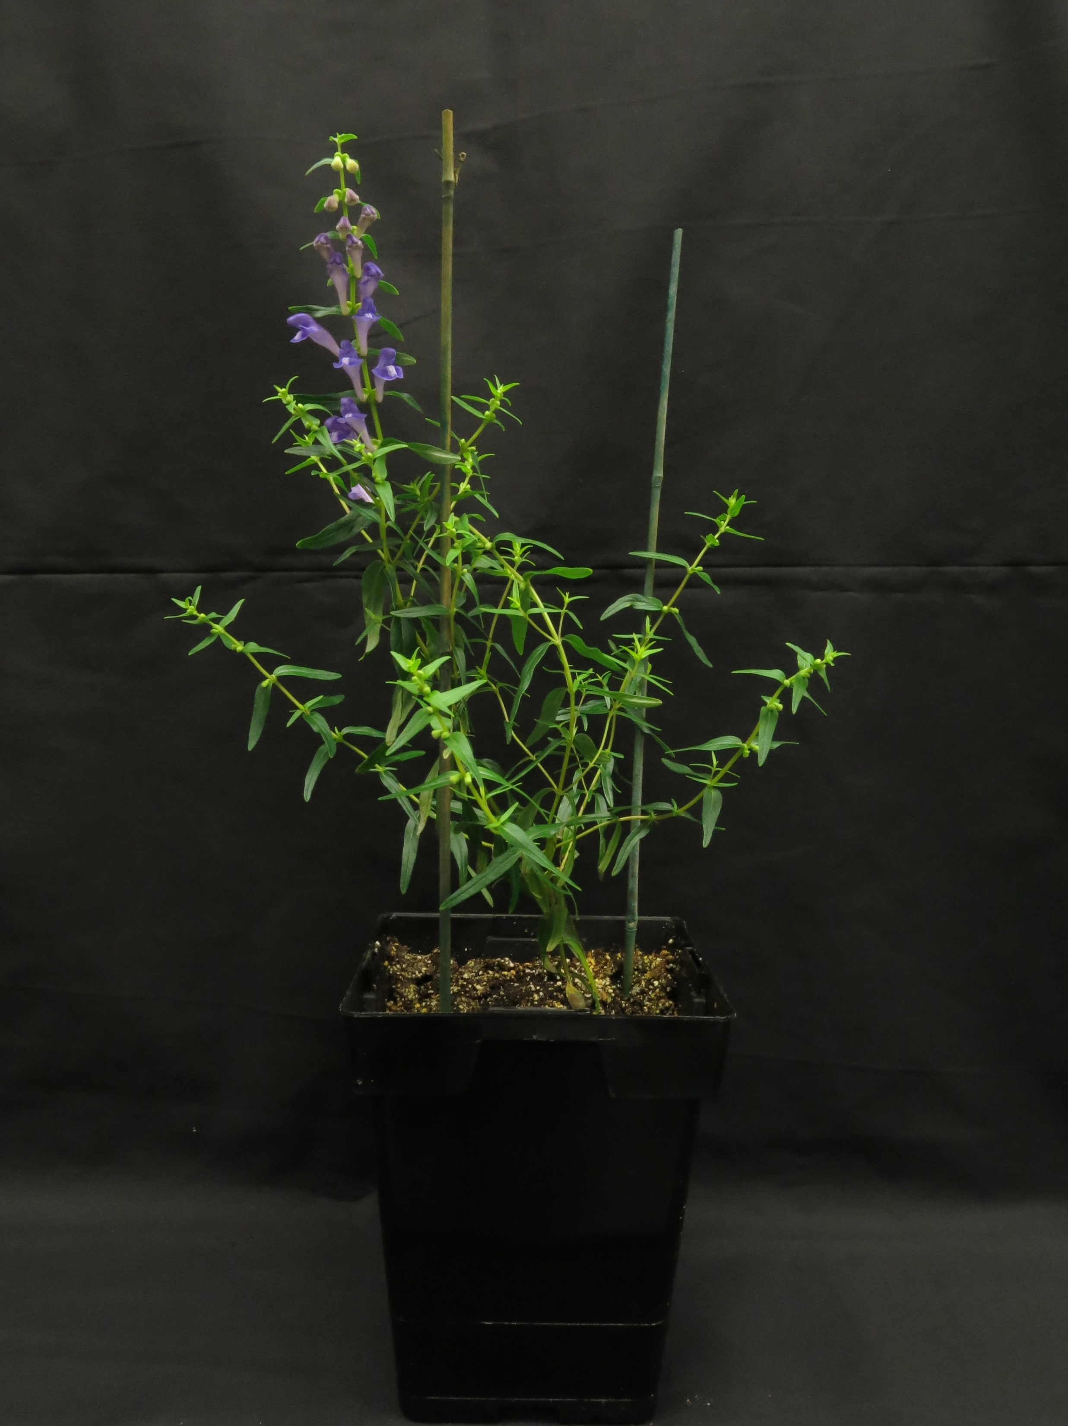
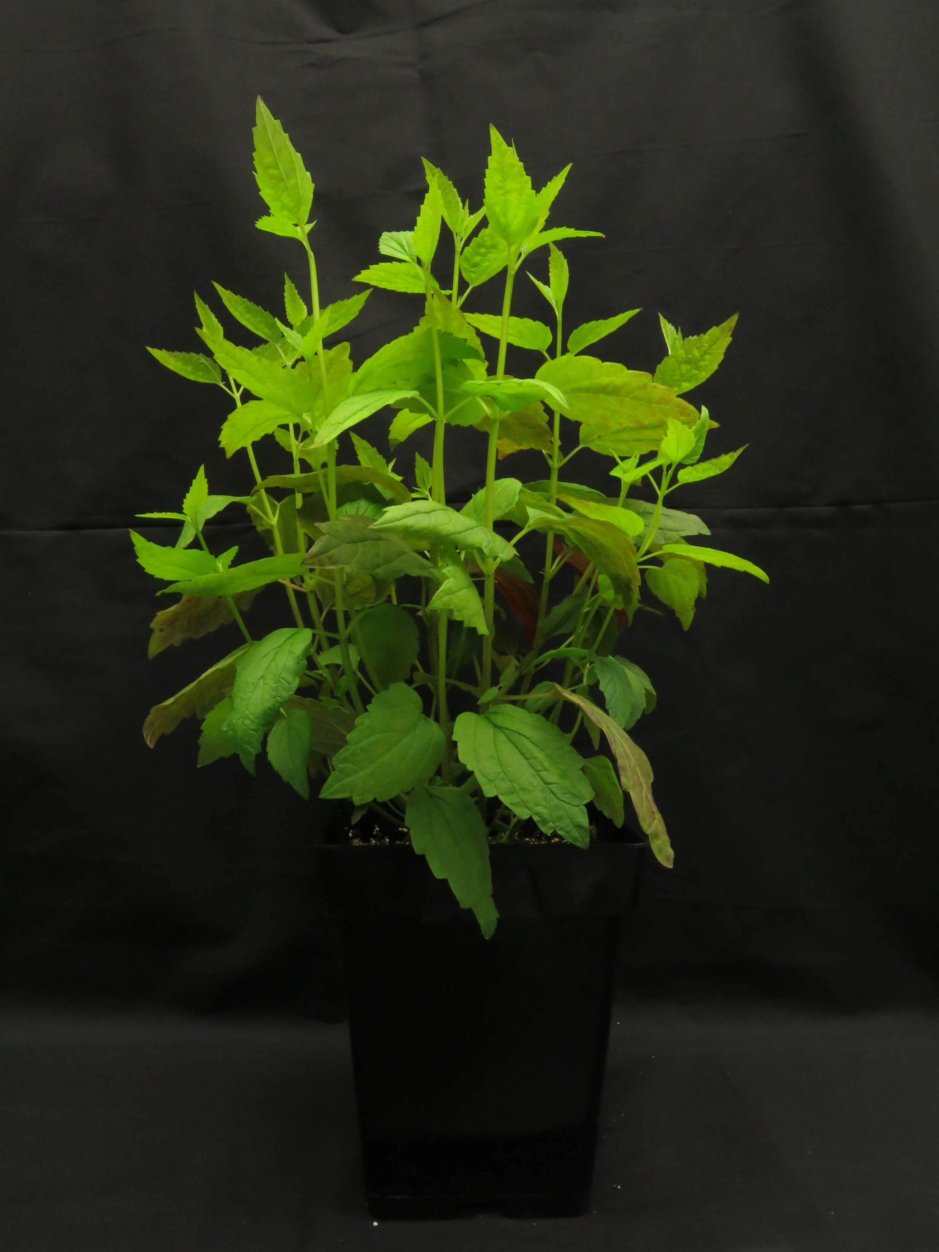
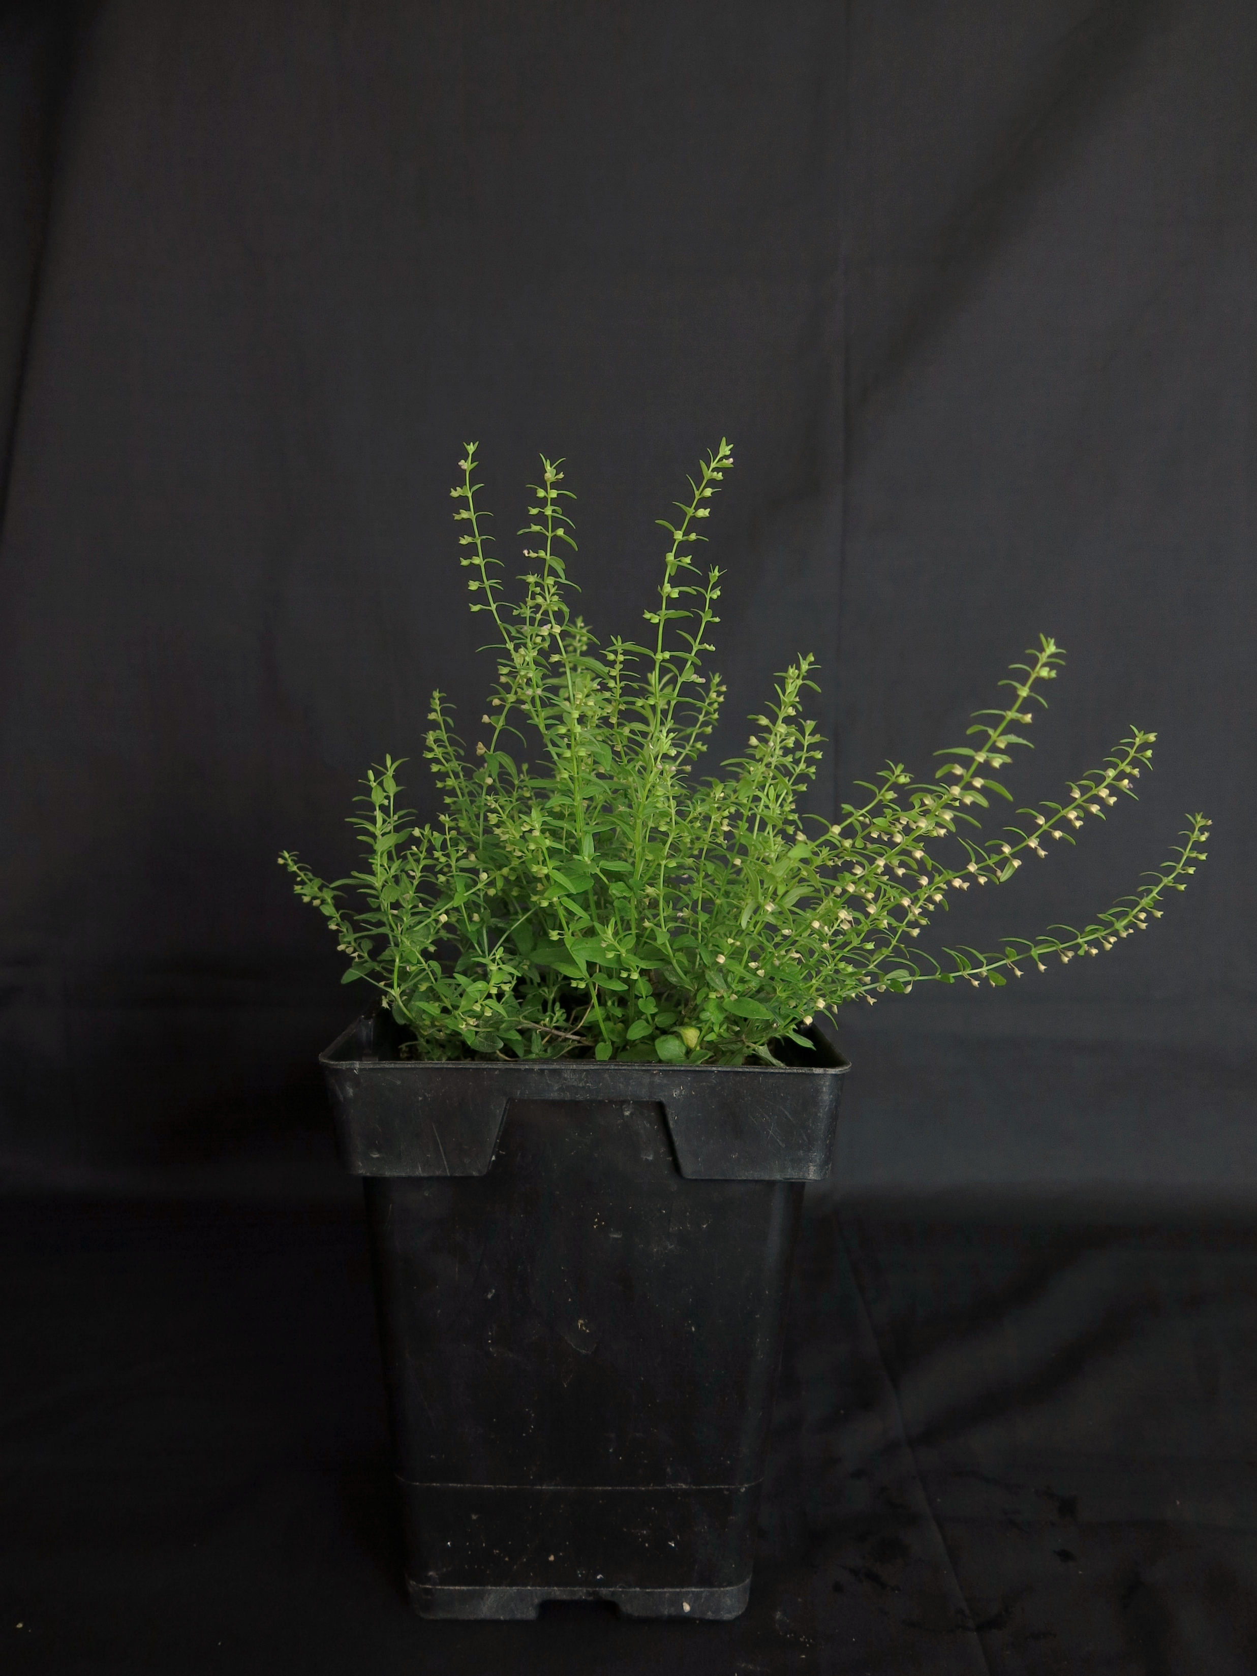
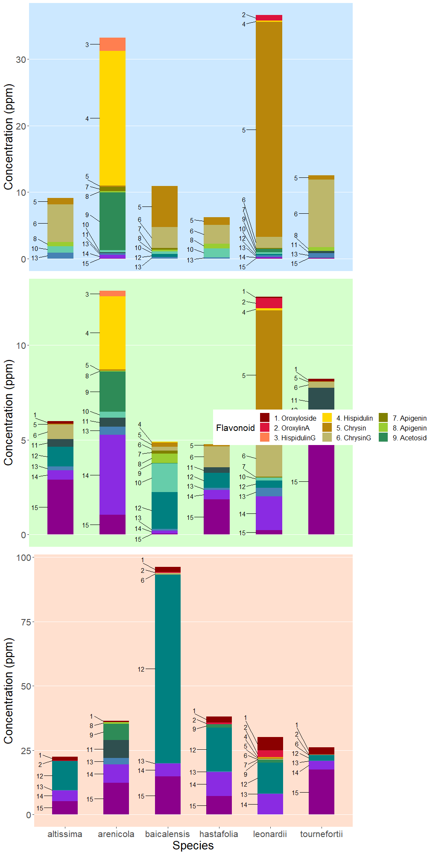
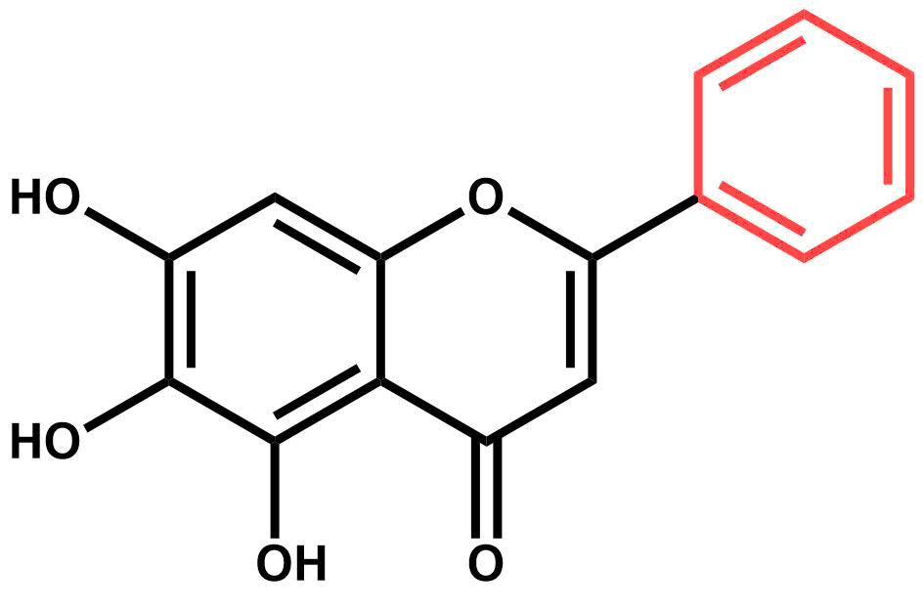
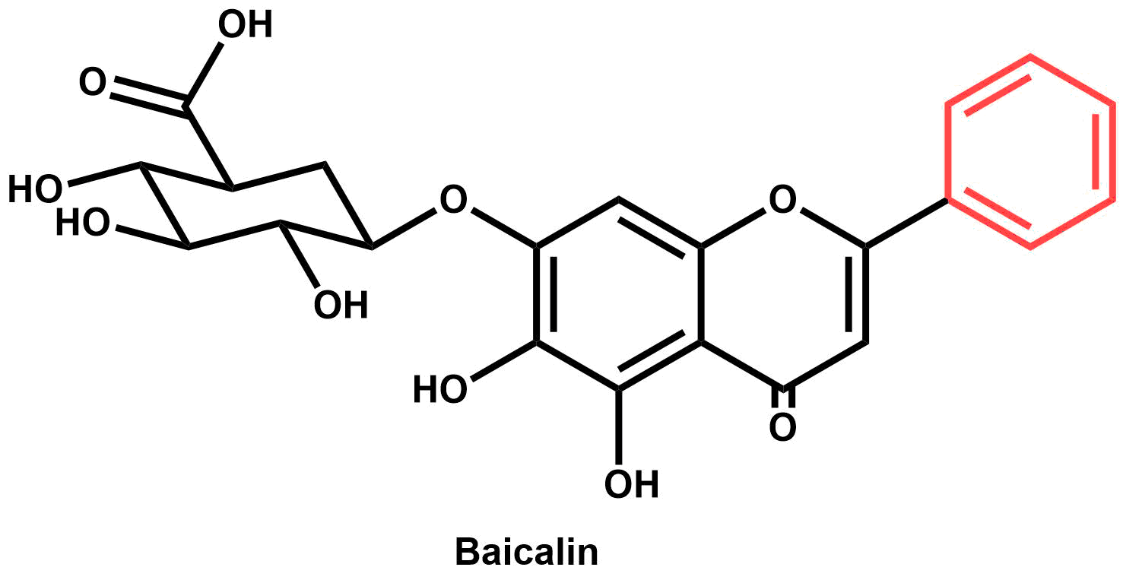
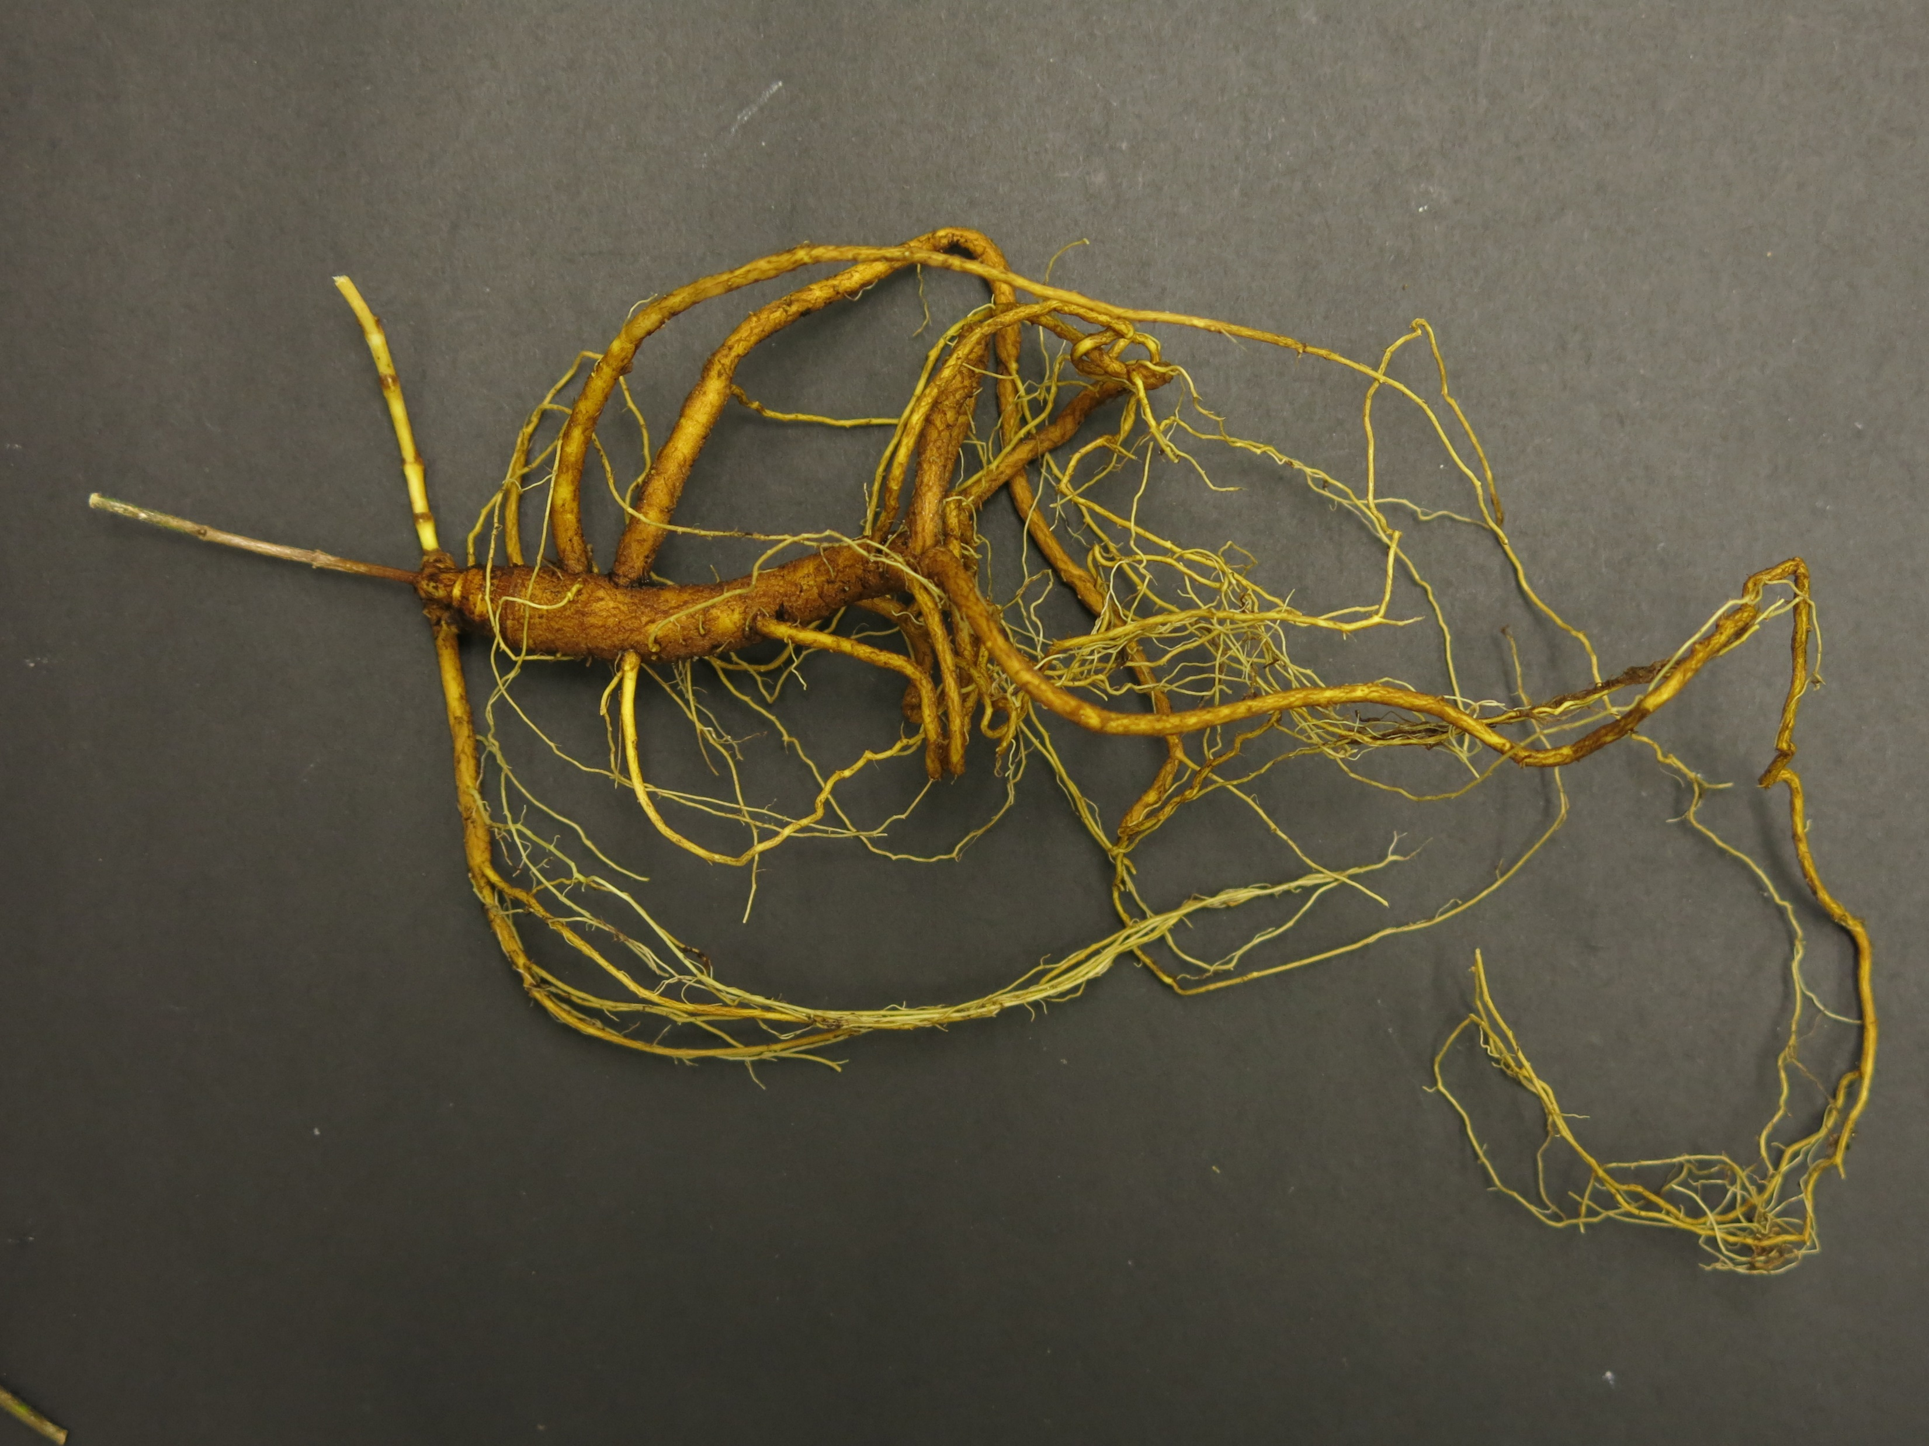
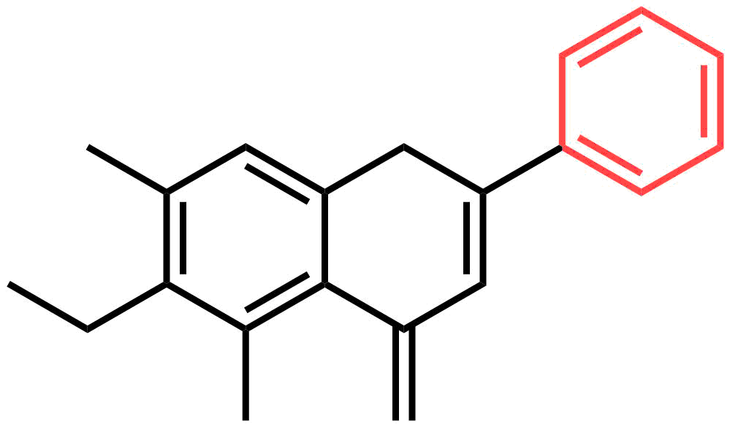
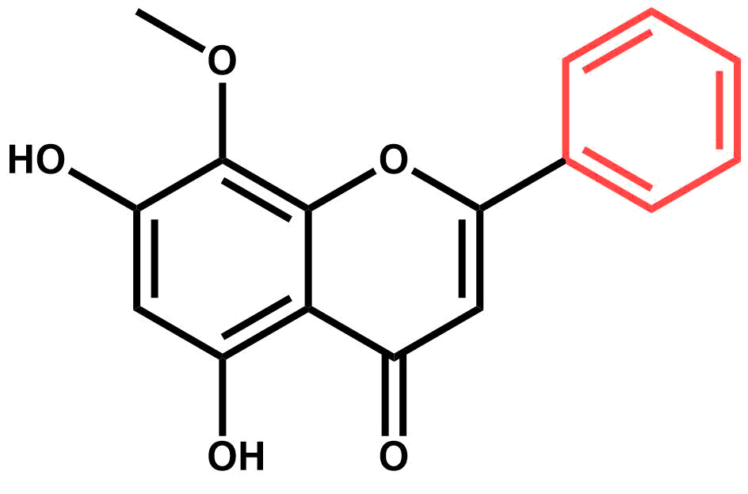
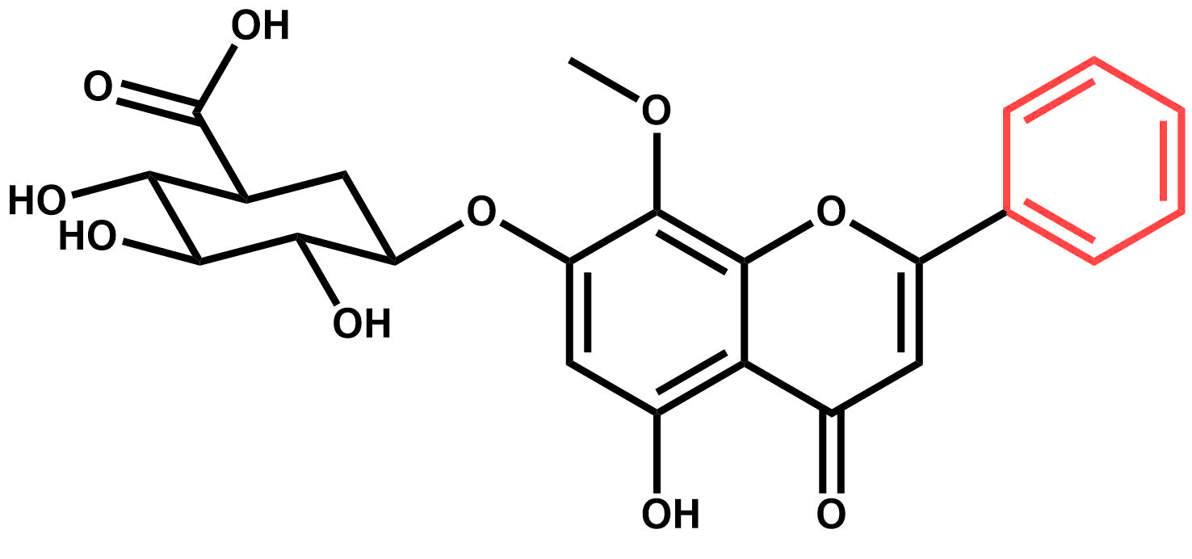


An investigation of flavonoid diversity in Scutellaria to identify species with medicinal potential
Bryce Askey¹, Yeong Hun Song¹, Yoonkyung Lee², Ru Dai¹, Sangtae Kim², and Jeongim Kim¹
¹Horticultural Science Department, University of Florida, Gainesville, FL
²Department of Biology, Sungshin Women’s University, Seoul, South Korea
Abstract
Methods and Results
Scutellaria baicalensis is a medicinal plant whose root extracts have been widely used in Asian medicine for more than 2,000 years. Although S. baicalensis has been well-studied, the majority of the 470 species in the Scutellaria genus have not been analyzed. This study aims to extend the current knowledge of Scutellaria by analyzing flavonoid profiles and genome sizes of a large set of species representing the diversity in the genus. Targeted metabolite analysis via High Performance Liquid Chromatography (HPLC) was used to quantify concentrations of 15 medicinally relevant flavones. The genome sizes of eight of the species analyzed were also estimated with flow cytometry. A comparison of phytochemical profiles indicate diversity in site and identity of accumulation for multiple species when compared to S. baicalensis. Inconsistences in site of accumulation imply significant differences in biosynthetic pathway exists for several species. Researchers studying Scutellaria can use the results of this work to identify previously uncharacterized species with medicinal potential, aiding in the development of new drugs and treatments.
Leaves
Background
Scutellaria baicalensis is a medicinal plant
Root extracts are used in traditional Chinese medicine
Huang Qin – commercially sold powder of S. baicalensis roots
The medicinal properties of S. baicalensis are well-studied
Proven medicinal effects: anti-Alzheimer’s, anxiolytic, anti-cancer, and angiogenic
Specific phytochemicals responsible have been identified
Reference genome recently completed
Proposed flavonoid biosynthetic pathway explains organ-specific accumulation
However, the Scutellaria genus contains >470 species of plants
Little is known about the medicinal relevance of most of the genus
Phytochemical profiles are not well-studied/not studied at all
Uncharacterized species could possibly accumulate medicinally valuable compounds at higher concentrations than species currently studied
Goal: Analyze a large set of Scutellaria plants representing the diversity in the genus to identify species with medicinal potential for further study
Objectives:
Identify species of interest by quantifying medicinally relevant flavonoids in total (i.e. not organ-specific) samples
Analyze organ-specific samples from species of interest to determine site of accumulation of medicinally relevant flavonoids
Estimate genome size for species of interest to evaluate ease of further genetic study/improvement
A.
B.
Shoots
Figure 3. Heatmap of flavonoid concentrations for 34 Scutellaria species analyzed.
Chemical analysis of total samples
Targeted metabolite analysis performed with High Performance Liquid Chromatography
Concentrations of 15 medicinally relevant flavonoids were quantified
34 species of Scutellaria were analyzed
Dried (herbarium) samples prepared at 1000 ppm (1 mg sample / 1 mL solvent)
Fresh samples prepared at 5000 ppm (5 mg sample / 1 mL solvent)
Organ-specific chemical analysis
6 species were selected for further analysis
HPLC used to quantify flavonoids in different organs of plant - leaves, shoots, and roots
Differences in site of accumulation imply differences in flavonoid biosynthetic pathway
C.
Figure 1. Morphological differences between (A) Scutellaria baicalensis, (B) S. lateriflora, and (C) S. racemosa plants illustrate the diversity of the Scutellaria genus.
Roots
Estimation of genome size
Genome sizes of selected species were measured with flow cytometry
4 species have similarly sized genomes to S. baicalensis
Allows comparison to S. baicalensis reference genome
Overall genome sizes are small
Ex: Artemisia annua (source of anti-malaria drugs) has a 1.74 GBP genome
Table 1. Genome sizes for selected species.
Species | Standard plant | 1C (Mean) | SD | Genome size (GBP)
altissima | Solanum | 0.40 | 0.02 | 0.39
arenicola | Glycine | 0.87 | 0.02 | 0.85
baicalensis | Solanum | 0.55 | 0.00 | 0.54
hastifolia | Solanum | 0.39 | 0.04 | 0.39
leonardii | Glycine | 0.51 | 0.02 | 0.50
tournefortii | Solanum | 0.40 | 0.01 | 0.39
Figure 4. Results of organ-specific flavonoid analysis for selected species.
Conclusions
A diverse range of flavonoid profiles were observed in the 34 species of Suctellaria studied. For the 6 species selected for organ-specific analysis, differences in site of accumulation suggest distinct biosynthetic gene expression between different species. Genome sizes for 4 of the species analyzed are similar to that of S. baicalensis, indicating that the published reference genome for S. baicalensis can potentially be used in comparative genomic and transcriptomic studies with these species. Future work will include analysis of an even larger set of Scutellaria species, phylogenetic study to identify clades of plants with medicinal potential, and transcriptomics to pinpoint genes involved in the biosynthetic pathway.
Baicalein
Baicalin
References and Acknowledgements
Oroxylin A
Shang, X., He, X., He, X, Li, M., Zhang, R., Fan, P., Zhang, Q., and Jia, Z. (2010). The genus Scutellaria an ethnopharmacological and phytochemical review. Journal of Ethnopharmacology, 128, 279-313.
Gasiorowski, K., Lamer-Zarawska, E., Leszek, J., Parvathaneni, K., Yendluri, B.B., Blach-Olszewska, Z., and Aliev, G. (2011). Flavones from root of Scutellaria baicalensis Georgi: drugs of the future in neurodegeneration? CNS & Neurological Disorders – Drug Targets, 10(2), 184-191.
Wogonin
Wogonoside
We thank Brian Pearson from the Environmental Horticulture Department at the University of Florida, and John B. Nelson from the University of South Carolina Herbarium for providing seed and plant materials used in this study.
Anti-Alzheimer’s
Anxiolytic (anxiety reducing)
Anti-cancer
Angiogenic (promoting formation of new blood vessels)
This work was supported by the National Research Foundation of Korea (NRF-2017R1D1A1B03034952) for S.K., and NIFA-HATCH Project #005681 for J.K. and B.A.
Figure 2. S. baicalensis root extracts contain a variety of flavonoids with medicinal properties.

